Slide 1
Discussion
Barbieri Claudio, Delera Giacomo, Huser Cyril, Howe Alessandro
Econometrics project 2024/2025
Lecturer: Azzone Michele
TA: Sala Edoardo

Slide 2

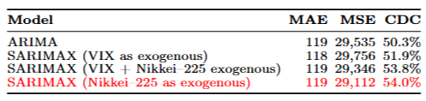
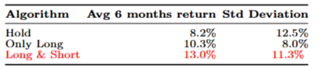
Related work and main results
Objective: forecast the NIFTY 50 index using econometric models to drive trading strategies
Data: Jun 2018–Jun 2025 daily closes of NIFTY50 and Nikkei 225 and daily opens of Indian (?) VIX
Preliminary tests:
- ADF → VIX is stationary; NIFTY50 and Nikkei 225 are non-stationary and first differences are taken
- Granger causality → Nikkei 225 Granger-causes NIFTY50
Models: SARIMAX models with orders selected by
the lowest AIC and re‑estimated on a rolling window
Trading strategies:
Hold: Buy‐and‐hold the NIFTY 50 for the entire period.
Only long: Go long when forecast > daily risk‑free rate (DRF); otherwise stay in cash.
Long&Short: Go long if forecast > +DRF, short if forecast < -DRF , else cash.

Slide 3
Question
Is the assumption of zero transaction costs plausible? Why transaction costs matters:
No Market is Free:
Every real-world trade incurs bid-ask spreads, brokerage fees, slippage and/or taxes.
Impact on Strategy Performance:
Ignoring costs overstates profitability and can invalidate back tests.
A strategy that looks profitable may actually yield net losses when realistic costs are applied..
Higher Frequency = Higher Costs:
Strategies with frequent trades suffer linear or even exponential cost accumulation.
Zero-cost assumption hides fragility in such approaches.

Slide 4
Thank you for the attention!

